Slide 1
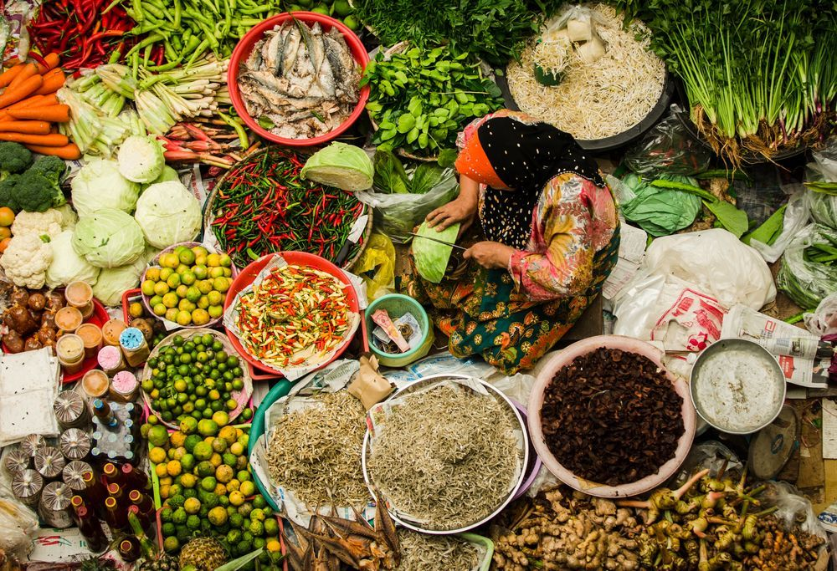
The Making of A Malaysian Gastronomy
Eric Olmedo
Anisha Chai

Slide 2
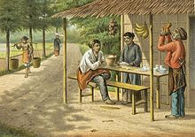
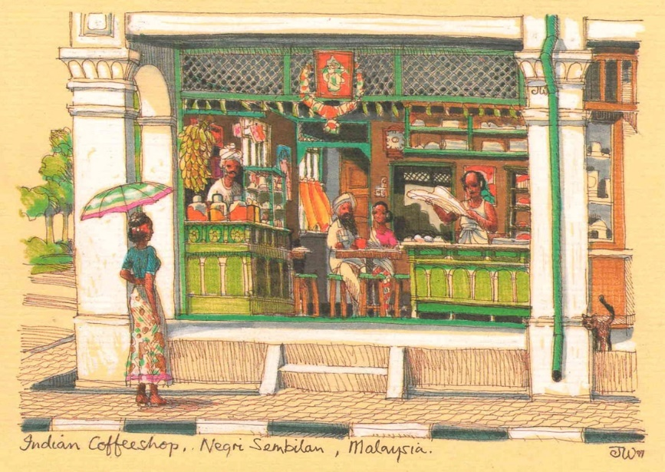
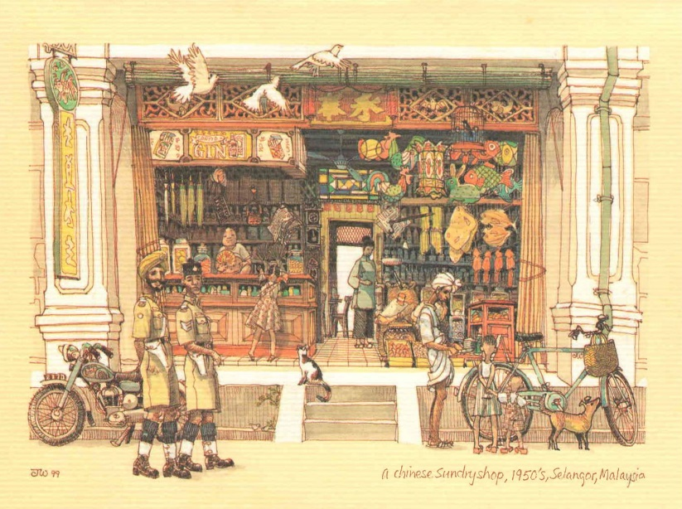
Many ethnicities, many cuisines
Malay Warung
Indian Coffee Shop
Chinese Sundry Shop

Slide 3
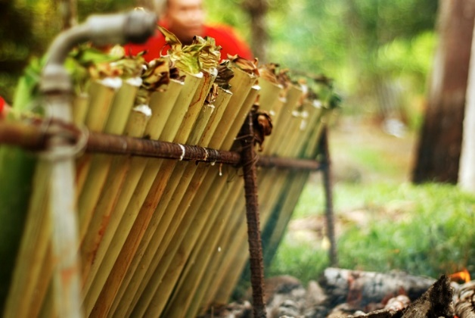
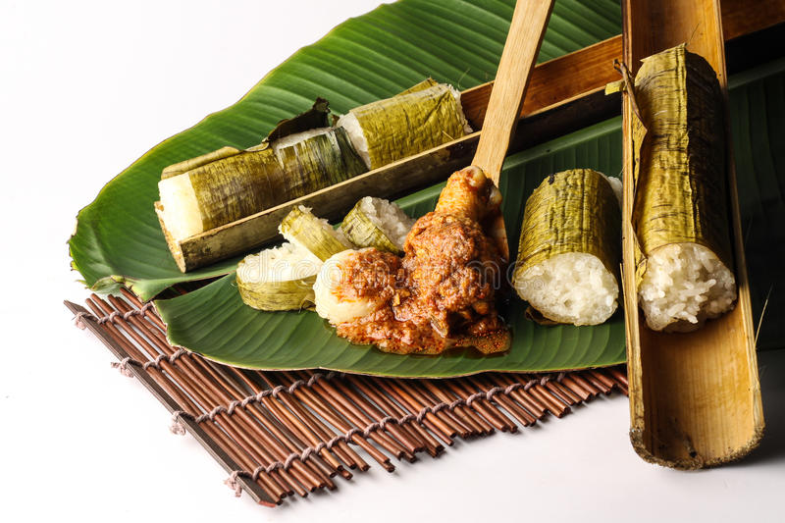
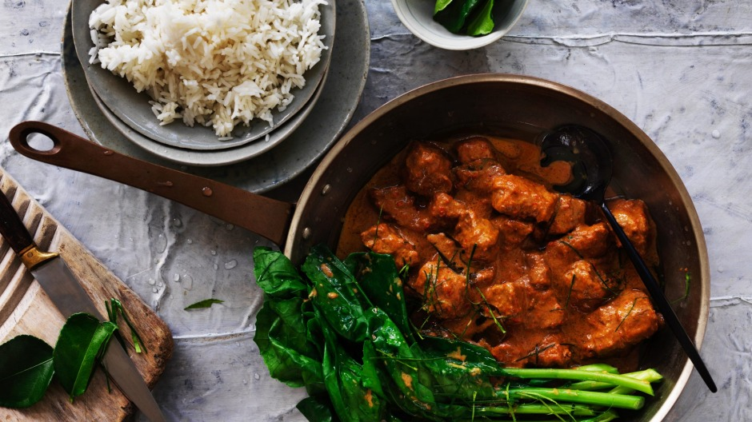
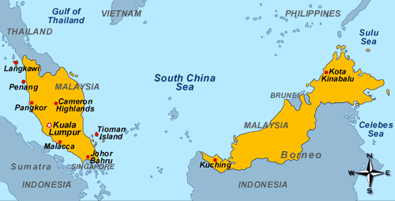
FOREWORD: THE MALAY ARCHIPELAGO
FESTIVE FOOD ON THE MALAY PENINSULA.

Slide 4
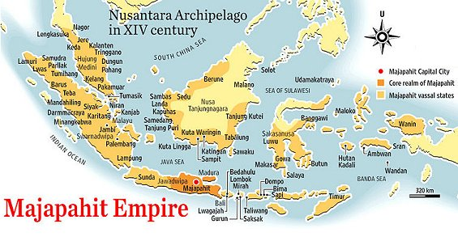
Snapshots of culinary history
Back tracking Malaysian cuisine

Slide 5
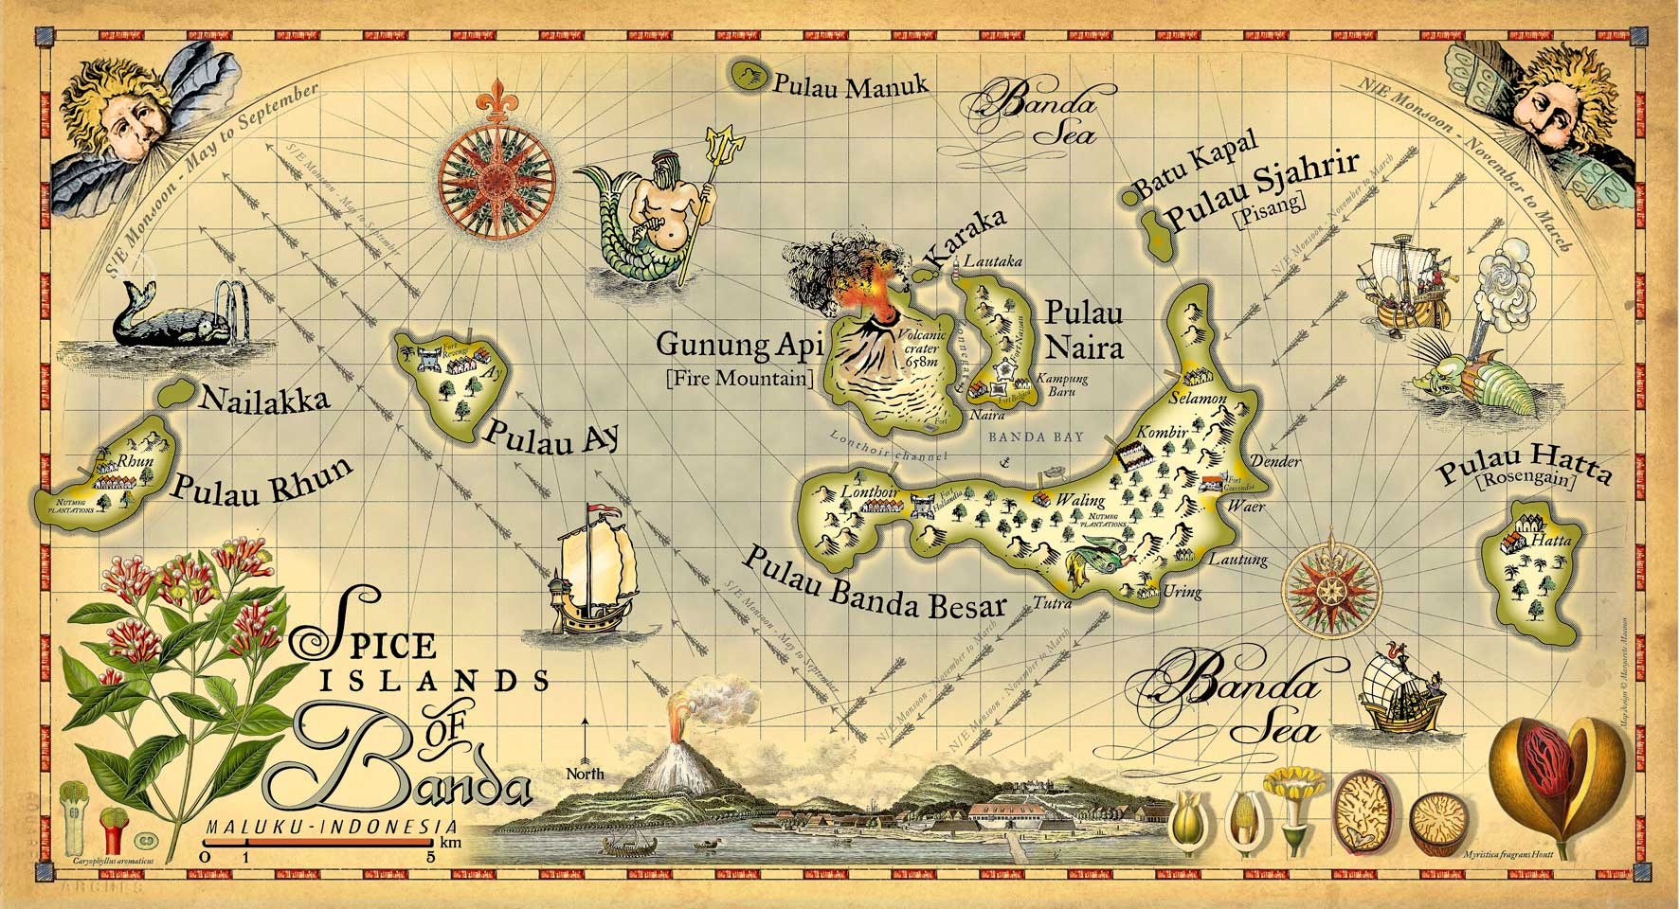
THE SPICE TRADE
14th century: the wealth from the Molucca (Maluku) islands.

Slide 6
THE RISE OF THE MELAKA SULTANATE circa 1400 AD
“WHOEVER HOLDS MALACCA HAS A HAND ON VENICE’S THROAT”.
Portuguese proverb, 16th century.

Slide 7
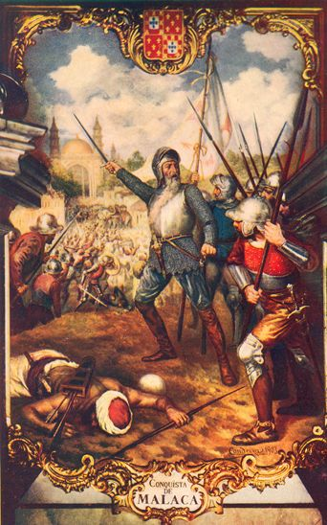
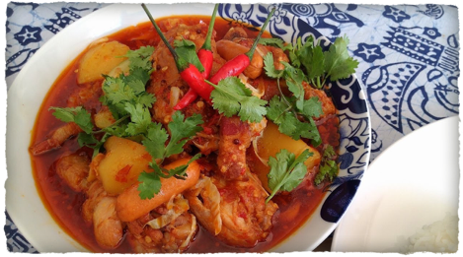
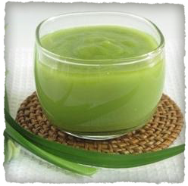
THE PORTUGUESE INFLUENCE 1511-1610
The Devils’ curry
The Kaya (“Doce de Ovo”)
1511 AD : The Conquest of Melaka by Alfonso de Albuquerque

Slide 8
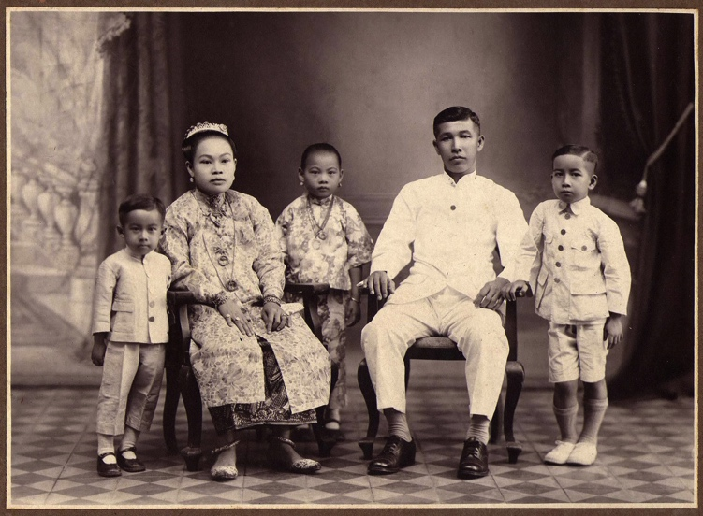
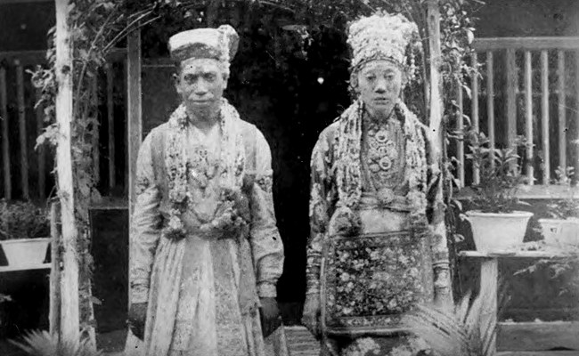
15th century onwards: THE PECULIAR CASE OF THE PERANAKANS Blurring ethnic boundaries
Peranakan-Indians: The “Chitties”
Melaka Chettis
Peranakan-Chinese
Baba-Nyonya of Melaka
The Jawi-Peranakan

Slide 9
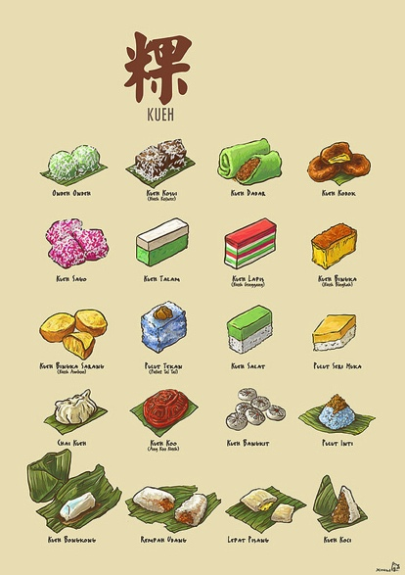
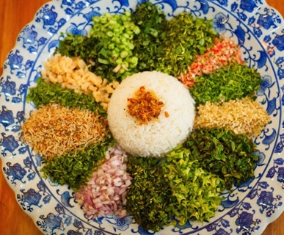
DIFFUSION OF PERANAKAN CUISINES One most iconic but commoditized

Slide 10
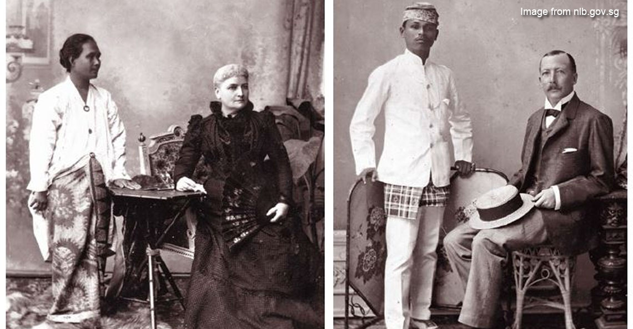
AFTER A DUTCH TRANSITION… 1824-1957: THE BRITISH INFLUENCE
1824: Signature of Anglo-Dutch Treaty
1957: Independence from British Empire

Slide 11
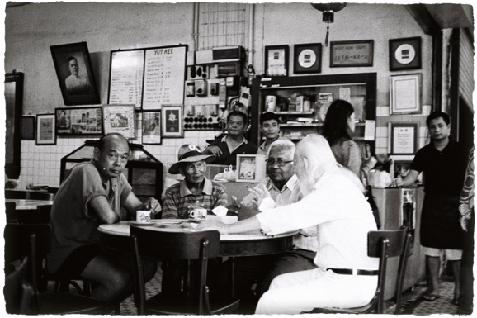
Kopitiam and the Hainanese Cookboys
Coffee Shop in
Hokkien dialect

Slide 12
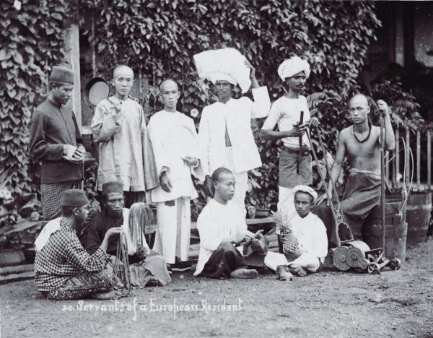
Kopitiam and the Hainanese Cookboys
Hainanese – latecomer and a minority immigrant group
Cooks and domestics in the European households

Slide 13
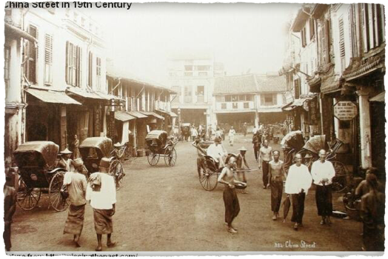
Kopitiam and the Hainanese Cookboys
Federation of Malaya’s independence in 1957
Unemployed Hainanese
Set up Kopitiam and related businesses using their skills acquired

Slide 14
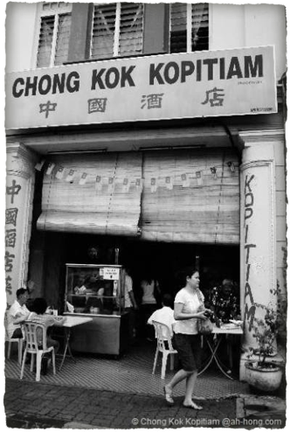
Kopitiam and the Hainanese Cookboys
What do they serve in Kopitiam?
What do they serve in Kopitiam ?

Slide 15
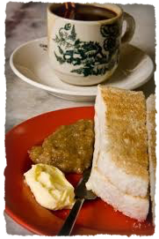
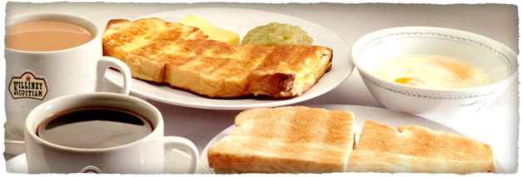
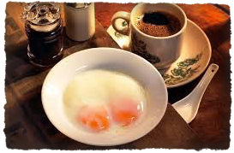
Kopitiam and the Hainanese Cookboys
Pocket of food creolization

Slide 16
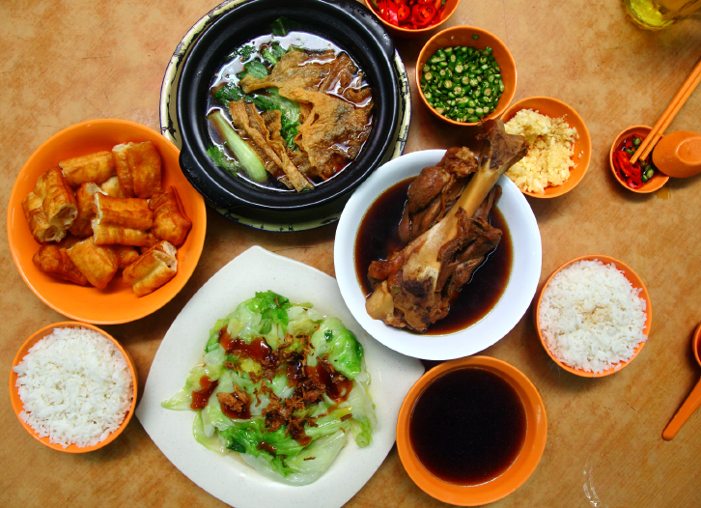
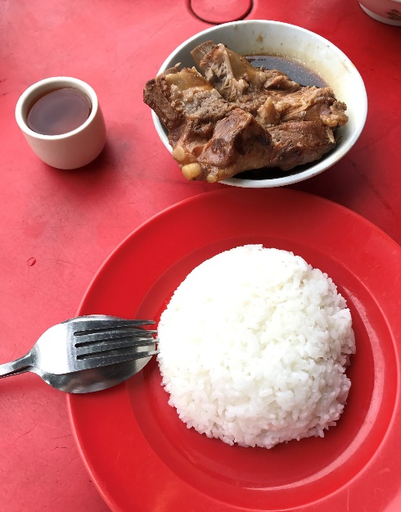
The Story of Bak Kut Teh
‘Bak Kut Teh’ 肉骨茶
Klang, port city in Selangor
Pork ribs braised in broth of soy sauce, star anise, Chinese angelica, rehmannia root and other Chinese herbs.
A bowl of rice.
- Extracted from Lee, HY (2017)

Slide 17
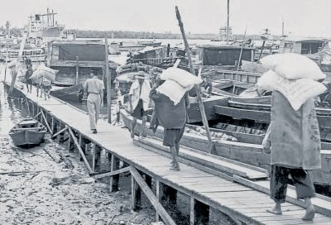
The Story of Bak Kut Teh
Hokkien - worked as carrier workers, usually bare footed
arthritis and rheumatism
The dish was created to improve bones and joint health
- Extracted from Lee, HY (2017)
Carrier workers at Port Klang. Adapted from ‘Klang History’ by Lim, 2000, retrieved from http://klanghistory.blogspot.my/2014/03/blog-post_9.html

Slide 18
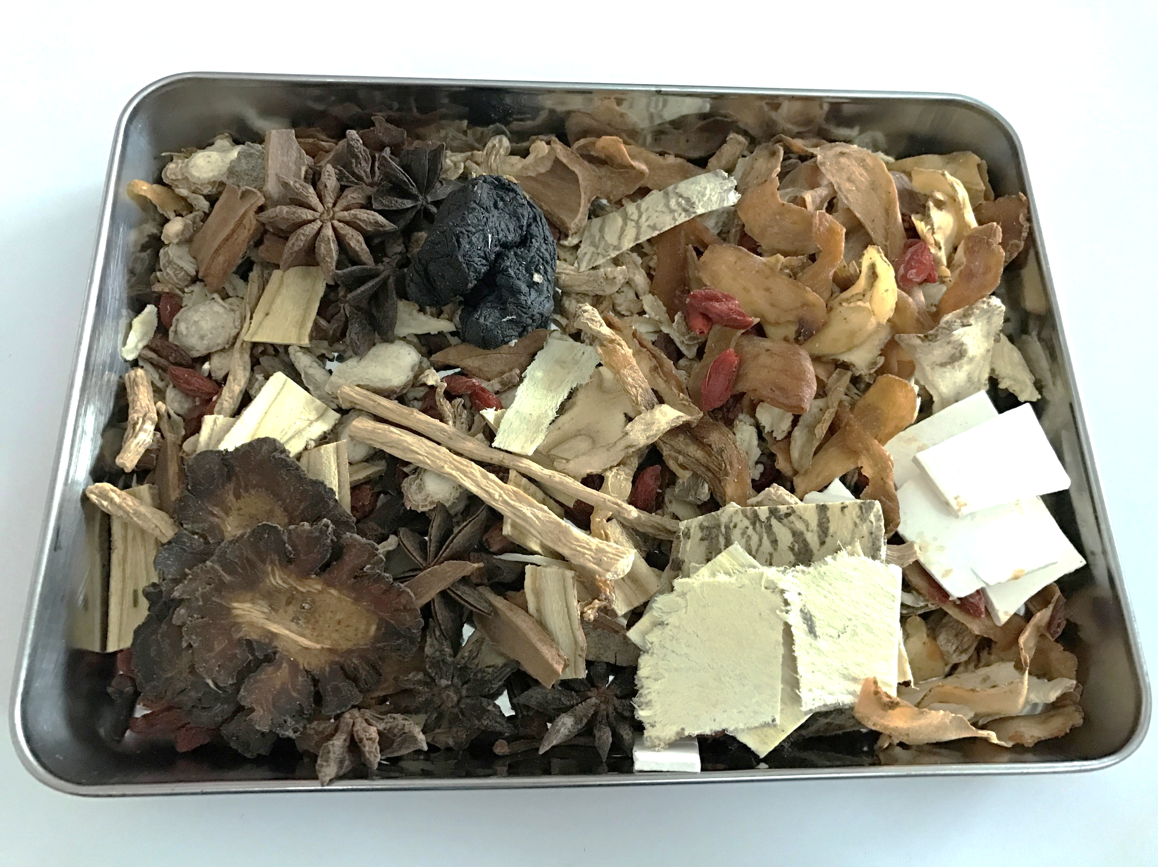
The Story of Bak Kut Teh
Concept of diet therapy according to traditional Chinese Medicine
Pork and herbs – flavours and medicinal purposes
Have an effect on ‘moisturizing dryness by nourishing yin.’ (Yang, 2003).
- Extracted from Lee, HY (2017)

Slide 19
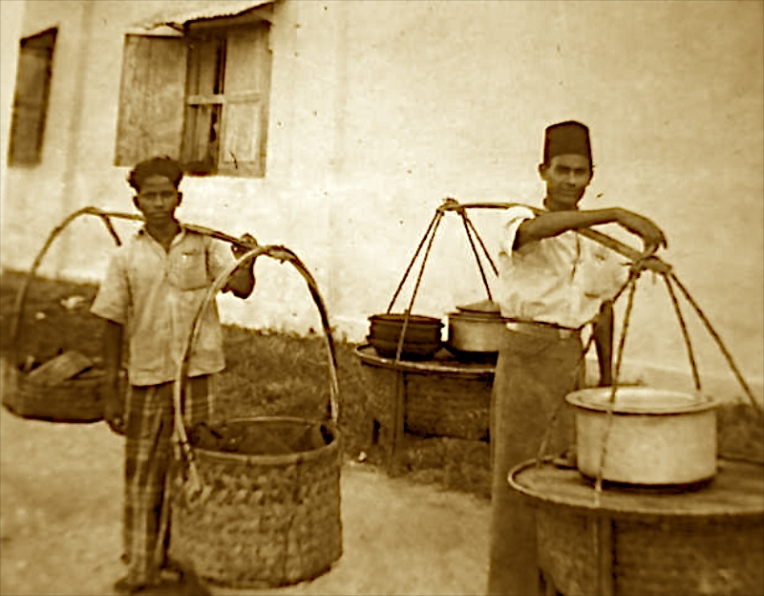
The Iconic Mamak
Indian Muslim
Nasi Kandar – started in the colonial Penang

Slide 20
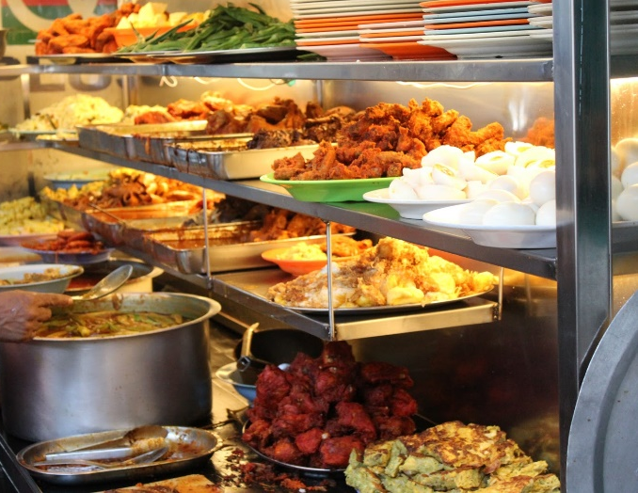
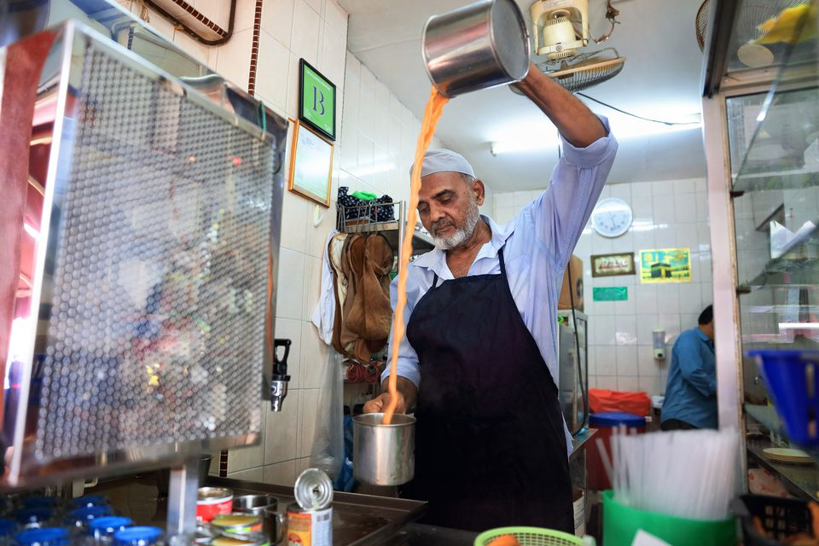
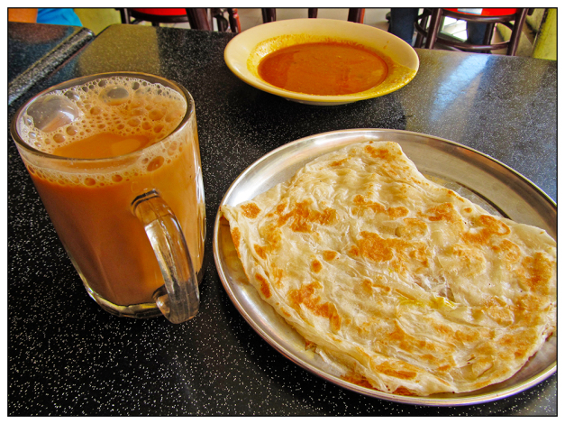
The Iconic Mamak
Beyond the food
A place of commensality that transcends ethnic and sociological boundaries
The notion of ‘Great Good Place’ – inclusivity and locality (Oldenburg, 1989)

Slide 21
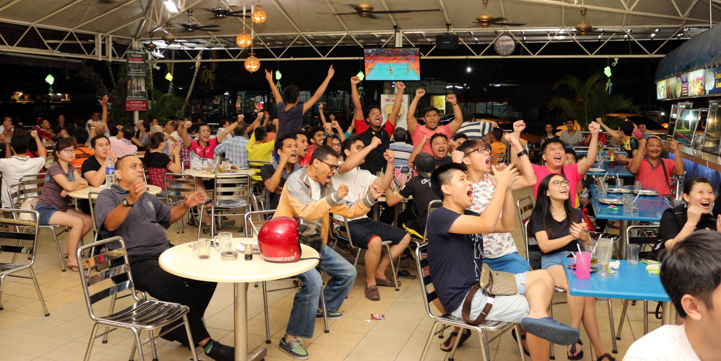
The Iconic Mamak
Can it possibly be a ‘Social Equalizer’?

Slide 22
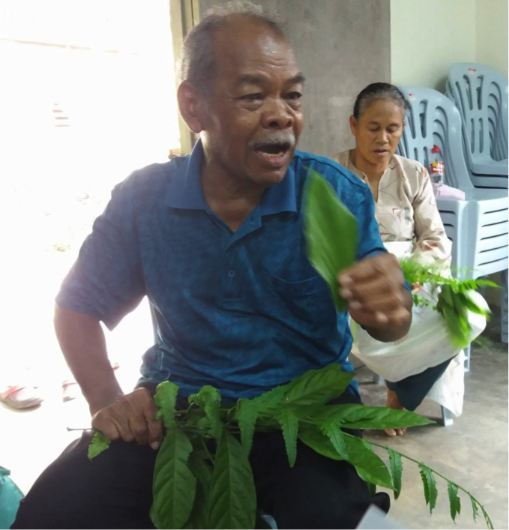
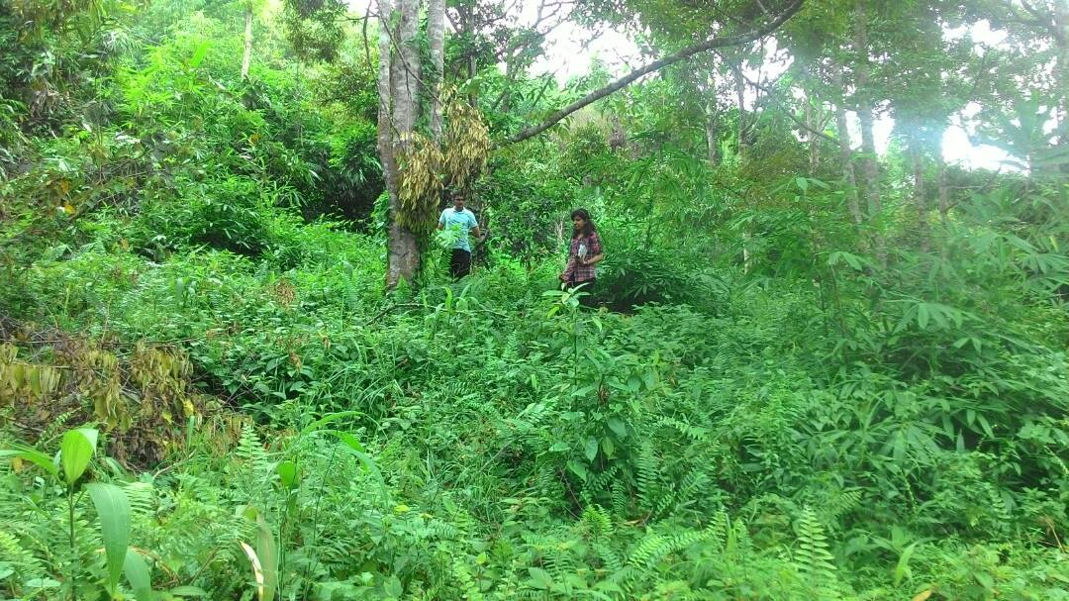
RECALLING FORGOTTEN KNOWLEDGE
The Orang Asli community from Peninsular Malaysia: guardians of traditional knowledge

Slide 23
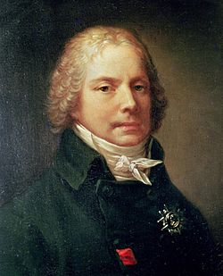
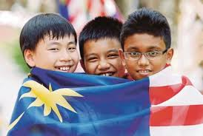
Gastronomy vs. National Cuisine
International Relations
National Unity
“The best weapon of a diplomat is his cook.”
“We need to view cookbooks (…) as revealing artifacts of culture in the making”.
Charles Maurice de Tayllerand
1754-1838
Arjun Appadurai, 1988.

Slide 24
SHAPING AN INCLUSIVE GASTRONOMY

Slide 25
CONCLUDING REMARKS
SEE YOU IN PARIS!
Check this out: www.food-and-society.com

Slide 26
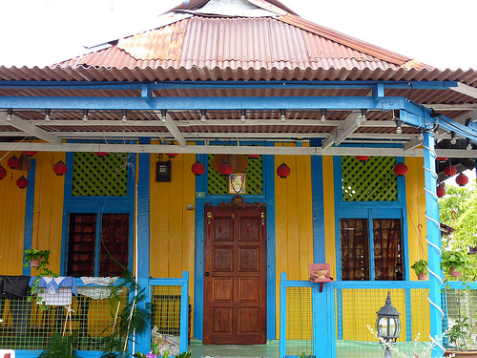
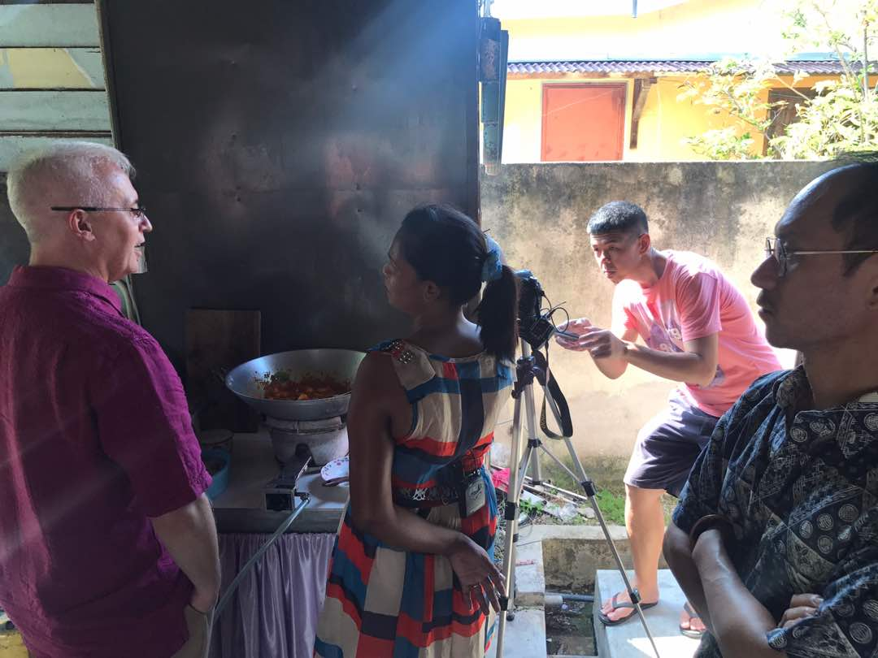
COOKING AT KAMPUNG CHETTI, MELAKA.
VIDEO: A quick glance at a unique cuisine from the Chitty community

Slide 27
BACK-UP SLIDES
For Q&A session

Slide 28
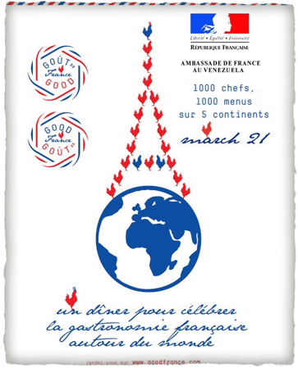
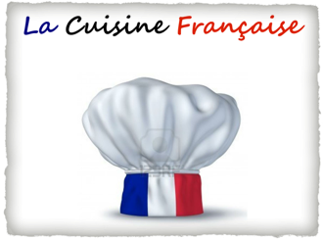
Gastronomy as “Soft Power”
Nationalism
vs.
International
Relations
“Soft power”: the power of attraction for a given country – often through cultural medium –
> antithesis to “hard power”: a form of coercion through military and/or financial means
(Nye, 2006).

Slide 29
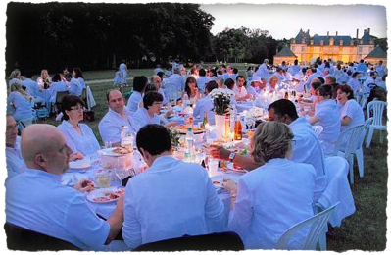
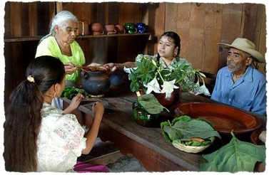
What medium to legitimate Malaysian Gastronomy as a form of soft power?
The French Gastronomic Meal
Mexican Traditional Cuisine
& the “Michoacán Paradigm”
2 potential benchmarks for Malaysia

Slide 30
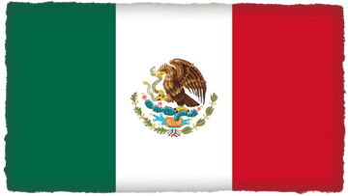
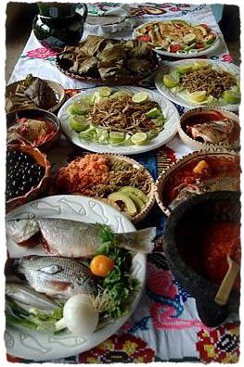
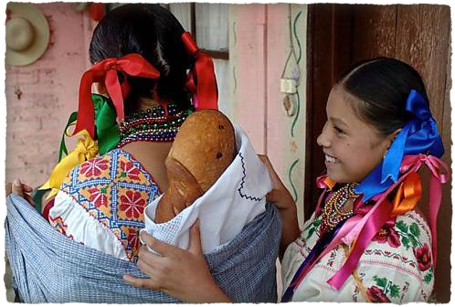
Mexico:
The Michoacán Paradigm
as alternative process of Gastronomisation

Slide 31
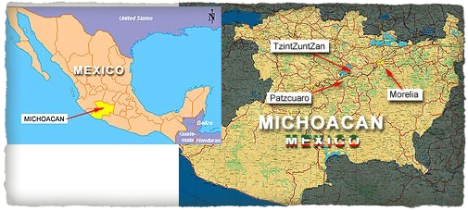
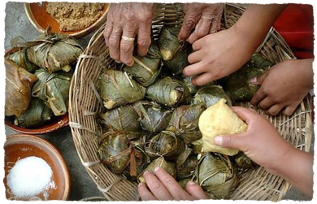
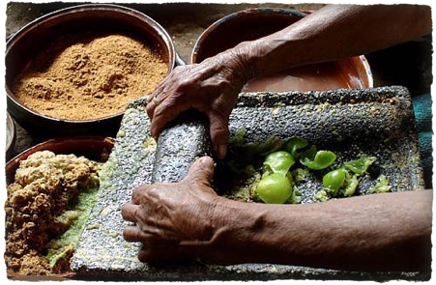
The Region of Michoacán
in MEXICO

Slide 32
The Michoacán Paradigm
Keywords:
Indigenous Cuisine
Sustainable Eco-System
La formación de una “cultura de uso y manejo ecológico del agua” que
está asociada con la cosmovisión purépecha del mundo

Slide 33
Invention of a New “Haute Cuisine”
The “naming effect”: Michoacán/Mexican Traditional Cuisine
UNESCO merges 2 foodways & links the Local to the Cosmopolitan
Creates a success story and endorses the birth of the
“Haute Traditional” Cuisine (Sammells, 2016).

